Slide 1
Load and stress system test
Liel Keren

Slide 2
The problem
The problem load and stress in a system are when a lot of users use the system. most of the time the operation involves http requests and many other requests and calculations and sometimes computers on which the system sits do not handle the load and courses or the performance of employees is less good

Slide 3
The problem
The problem load and stress in a system are when a lot of users use the system. most of the time the operation involves http requests and many other requests and calculations and sometimes computers on which the system sits do not handle the load and courses or the performance of employees is less good

Slide 4
way unit tests and acceptance tests is not enough ?
Unit tests and acceptance tests do not cover these cases of stress and load tests because they test single or limited use of the system to check the logical correctness of the system and not to check load or a large amount of users doing the same operation in parallel

Slide 5
A possible tool that allows the definition and execution of system stress and load tests
Apache JMeter™
The Apache JMeter™ application is open source software, a 100% pure Java application designed to load test functional behavior and measure performance. It was originally designed for testing Web Applications but has since expanded to other test functions
What can I do with it?
Apache JMeter may be used to test performance both on static and dynamic resources, Web dynamic applications. It can be used to simulate a heavy load on a server, group of servers, network or object to test its strength or to analyze overall performance under different load types

Slide 6
This tool can be used to study the bottlenecks in the system by creating many users with the help of threads and performing by-loop operations in the system (for example, sent login request with multiply users simultaneously and opening a store/ buying products, etc.)

Slide 7
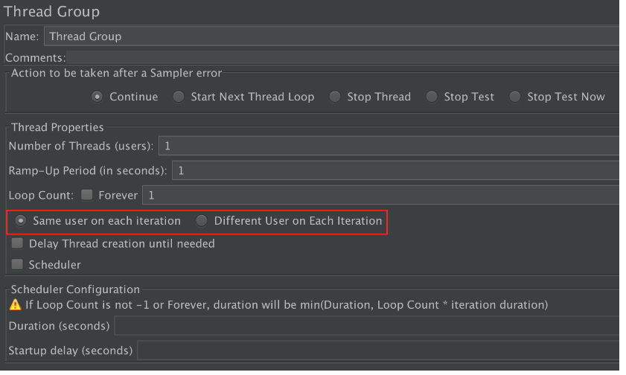
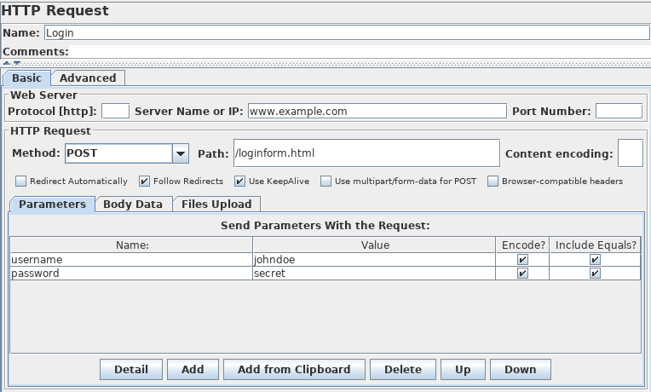
Uses example

Slide 8
,

